Slide 1
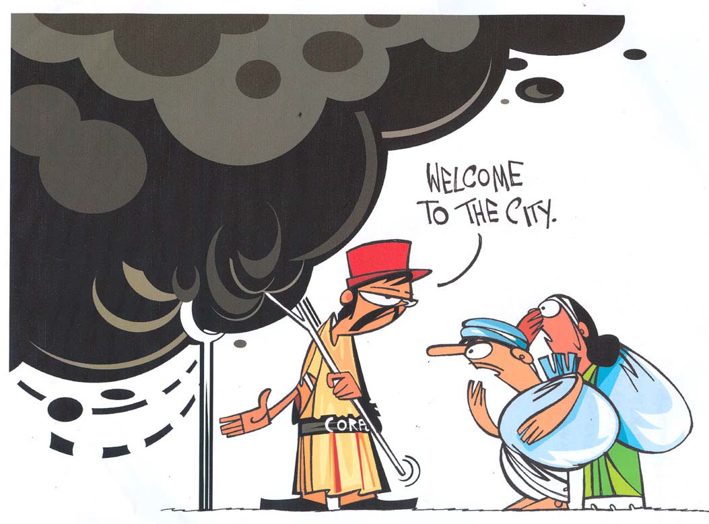
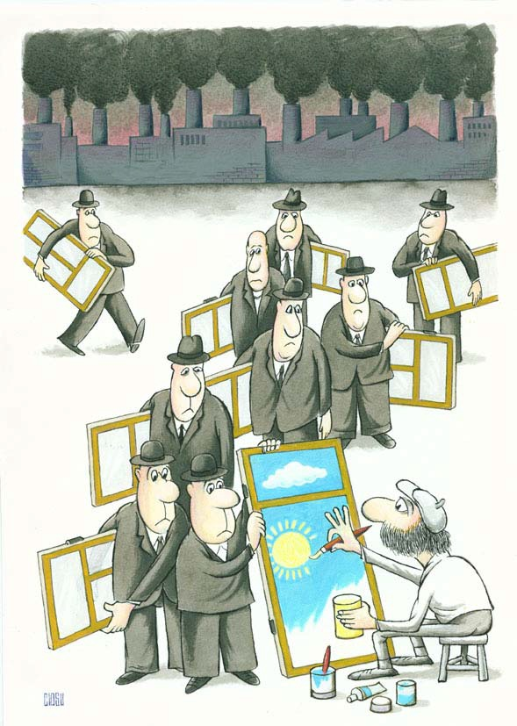
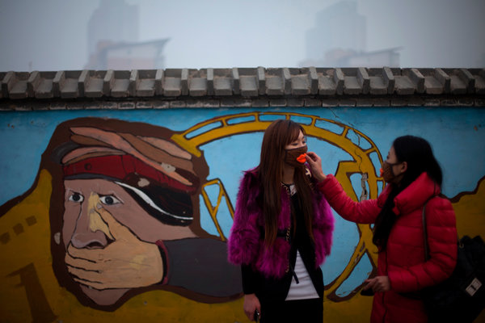
On Scale of 0 to 500, Beijing’s Air Quality Tops ‘Crazy Bad’ at 755 (Source: NYT)*

Slide 2
The State of the World's Children 2012:
Children In An Urban World
Governments (should) put children at the heart of urban planning and finds that for millions of children urban poverty is intensified by exposure to disasters.
Nearly eight million children died in 2010 before reaching the age of five, including two million from polluted indoor air caused by inadequate ventilation in sub-standard housing. City life also exposes children to high levels of outdoor air pollution and traffic accidents.
Children are at high risk in such locations, as they seldom have access to information or protective infrastructure, that can help people withstand extreme events.

Slide 3
Urbanisation of Poverty (million): 1983-2004

Slide 4
  McKinsey (2010) India's Urban Awakening
2008-2030: Assumption of 7.4 percent growth rate per annum
  Recycling Old Wine: Implement 74th amendment- decentralization
Mumbai’s GDP is projected to reach $ 265 billion by 2030
Addressing life in India’s cities is clearly not an elitist endeavor but rather a central pillar of inclusive growth

Slide 5
  Opening a Can
A physicist, a chemist, and an economist are shipwrecked on a desert island with only a can of beans to eat and no way to open it.
The physicist makes a suggestion: "I can calculate just the right angle, mass, and velocity of a projectile that will knock the top off the can." "No!" the economist cries, "That might spill the beans.“
The chemist then says, "I can make a compound from some local plants that will eat through the tin and open the can." "Fool! That would contaminate the beans!" says the Economist.
Exasperated, the other two ask the economist if he has a plan. "Of course!" says the economist, "The solution is simple. First, we assume we have a can opener..."
The McKinsey Report makes many assumptions

Slide 6
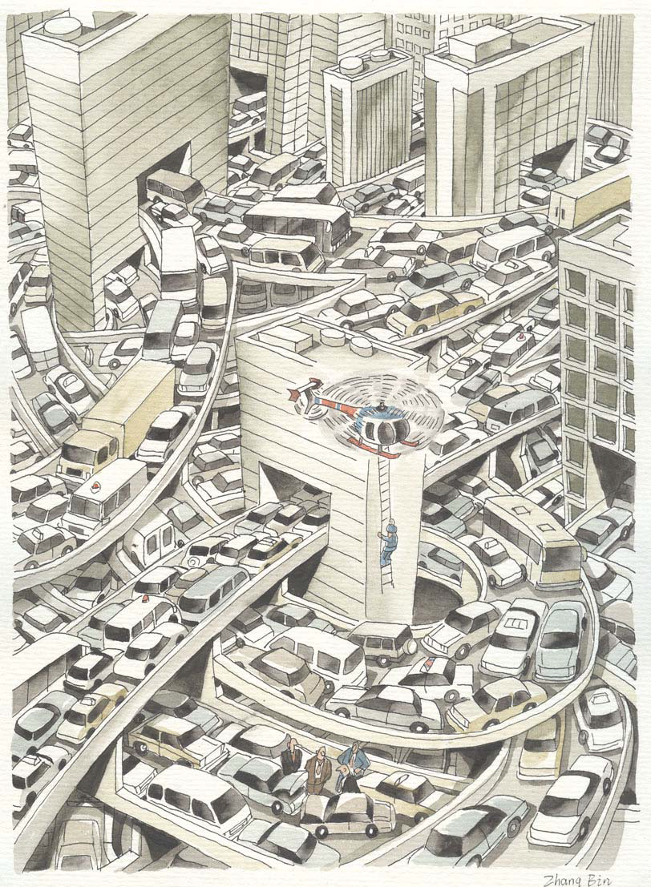

Slide 7
Will India’s Cities be the Engine for the Growth Process?
Depends on the Headwind and Tailwind
S. Chandrasekhar
chandra@igidr.ac.in
Indira Gandhi Institute of Development Research

Slide 8
Thinking of Cities
Architecture
Unlocking Land Values
Livelihoods
Undisciplined
Kinetic
Anonymity Vs Segregation
Monetization of the Urban Economy

Slide 9
In the Indian Context What is Urban?
All places with a municipality, corporation, cantonment board or notified town area committee, etc are Statutory Towns
An urban agglomeration is a continuous urban spread constituting a town and its adjoining outgrowths or two or more physically contiguous towns together with or without outgrowths of such towns. An Urban Agglomeration must consist of at least a statutory town and its total population (i.e. all the constituents put together) should not be less than 20,000 as per the 2001 Census

Slide 10
In the Indian Context What is Urban?
An Out Growth is a viable unit such as a village or a hamlet or an enumeration block made up of such village or hamlet and clearly identifiable in terms of its boundaries and location. Some of the examples are railway colony, university campus, port area, military camps, etc., which have come up near a statutory town outside its statutory limits but within the revenue limits of a village or villages contiguous to the town. While determining the outgrowth of a town, it has been ensured that it possesses the urban features in terms of infrastructure and amenities such as pucca roads, electricity, taps, drainage system for disposal of waste water etc. educational institutions, post offices, medical facilities, banks etc. and physically contiguous with the core town of the UA.

Slide 11
The Classification
Urban Agglomerations
Census Towns*
Statutory Towns
Out Growths

Slide 12
Number of Cities
 | 2011 | 2001
Statutory Towns | 4,041 | 3,799
Census Towns* | 3,894 | 1,362
Urban Agglomerations | 475 | 384
Out Growths | 981 | 962

Slide 13
Distribution of Population
377 million constituting 31.16% of the total population
264.9 million persons, constituting 70% of the total urban population, live in Class I UAs/Towns (population >100,000).
160.7 million persons (or 42.6% of the urban population) live in the 53 million plus Urban Agglomeration / Cities
Mega Cities: Greater Mumbai UA (18.4 million), Delhi UA (16.3 million) and Kolkata UA (14.1 million) Million Plus UAs/Cities

Slide 14
Census Town
At least 75 per cent of the male main working population engaged in non-agricultural pursuits*
A density of population of at least 400 persons per sq. km.
A minimum population of 5,000

Slide 15
Emergence of Cities
Scale Economics
(division of labour, assembly line)
Agglomeration Economics
(Eg: Skilled Workers, Clustering, IRS)
Transportation cost and firm location
Population clustering and natural advantage
Energy density and ease of access

Slide 16
The Indian City in History
Ease of Transport (river, roads), Trade Locations, Better Access to Natural Resources, Strategic Locations (expansion & control purpose)
Early Period
Mughal Period
Colonial Period
Post Independence till 1991
Post Liberalization Era
Annapurna Shaw (2011) Indian Cities, Oxford University Press

Slide 17
Planned Townships / Cities in India
Accommodate Refugees Post Partition
Steel Plants
Power Plant / Mining
Jamshedpur (Sakchi)
(1908 / 1912 /1919)
Modinagar (1933)
Gujarmal Modi

Slide 18
Economic Activity in Cities
Rourkela, Bokaro,
Bhilai: Steel
India’s Silicon Valley - Bangalore: Information Technology
Jamnagar: Oil Refinery
Lasalgaon (Census Town): Onion (Mandi Towns)
Kancheepuram (City):
Temple Town
Industrial Clusters

Slide 19
Land, Labour, Capital

Slide 20
Land Acquisition: Pfizer (New London, Conn)
Eminent Domain: The power to take private property for public use by a state, municipality, or private person or corporation authorized to exercise functions of public character, following the payment of just compensation to the owner of that property.
Supreme Court of USA ruled (5-4) in favor of City of New London - The city had created the New London Development Corporation to buy up the nine-acre neighborhood and find a developer to replace it with an “urban village” that would draw shoppers and tourists to the area.
2009: Pfizer said it would pull 1,400 jobs out of New London within two years and move most of them a few miles away to a campus it owns in Groton, Conn.
http://www.nytimes.com/2009/11/13/nyregion/13pfizer.html?_r=0

Slide 21
Movement of Labor: Rural-Urban
Harris-Todaro Model of Rural Urban Migration
Model of Rural Urban Migration with Land as a Constraint
Scenario A: Only the poor move from rural to urban
Scenario B: Only the non-poor move from rural to urban
Reality lies between these two scenarios
Decomposing the reduction in rural poverty suggests that over the period 1993-2002, migration accounted for only 19 percent of the reduction in worldwide rural poverty while 81 percent of the reduction could be ascribed to improved rural livelihoods (World Bank 2007).

Slide 22
Mobility of Workers- Migration (%)
Migration streams | Intra district (1) | Inter district (2) | Intrastate (1+2) | Interstate (3) | 1+2+3
Rural-Rural | 72.4 | 23.2 | 95.6 | 4.4 | 100
Rural-Urban | 41.2 | 33.6 | 74.8 | 25.2 | 100
Urban-Rural | 48.8 | 33.8 | 82.6 | 17.5 | 100
Urban-Urban | 27.9 | 49.2 | 77.1 | 22.9 | 100
Stream: RR-62 RU-19 UR-6 UU-13 (all)
Stream: RR-28 RU-38 UR-9 UU-25 (without marriage)

Slide 23
Mobility of Workers- Commuters (mn)
Location of Residence | Location of Workplace
 | Rural | Urban | Not Fixed | Total
Rural | 85.5 mn (87%) | 8.05 mn (8%) | 5.03 mn (5%) | 98.6 mn (100%)
Urban | 4.37 mn (5%) | 76.9 mn (87%) | 7.18 mn (8%) | 88.5 mn (100%)
Total | 89.9 mn (48%) | 85 mn (45%) | 12.2 mn (7%) | 187.1 mn (100%)

Slide 24
Typology of Households
Farm-oriented (more than 75% of total income from farm production); farm, market-oriented (more than 50% of agricultural production sold on market); farm, subsistence (<= 50% of agricultural production sold on market); labor-oriented household (more than 75% of total income from wage or nonfarm self employment); migration/transfers-oriented household (more than 75% of total income from transfers/other non-labor sources); and diversified households.

Slide 25
Exclusionary Urbanization Hinders R-U Migration
India’s Vice President: “our urban spaces and governance mechanisms have become the theatres for political conflicts and economic struggles. ‘Exclusionary’ urbanization is benefitting certain social groups to the detriment of others, and directing resources to large metropolises depriving small and medium towns of funds needed for infrastructure and essential services”.

Slide 26
Symptoms of Exclusionary Urbanization
High cost of living in the cities Urbanization of poverty
Decline in population growth rate in urban agglomerations – 2001-11
(Case of Mumbai, absolute decline – 2001-11)
Inadequate housing
Increase in population living in slum like conditions*
Decrease in rural urban migration rate among men Increase in return migration

Slide 27
  Fixing Service Delivery
Decentralization the buzz word (Indonesia Example)
Lack of Governance = Monopoly Power + Discretion – (Accountability + Low Salaries) – Lack of Institutional Structure (Markets and Non-Market Based Mechanisms)
Clearly define outcomes
Create sound regulatory, institutional and legal framework in order to promote accountability of
  Service provider to the user
  Policy maker to the user
  Service provider to the policy maker

Slide 28
Crossing Rural Urban Boundaries Everyday
Rural residents will not have to give up the benefits of programmes, Income diversification strategy for rural households
Manufacturing: Preliminary evidence that formal sector moving from urban into rural areas and informal sector is moving from rural to urban
Affordable housing, Improved transport connectivity*, City development plans are providing amenities for residents in peri-urban areas
One could observe two-way commuting among residents of small towns and nearby villages if the town does not have a strong economic base to employ all its residents

Slide 29
Flow of Investments and Climate Change
Investments are flowing to districts and cities (low elevation coastal zone) at risk of climate change induced events
Till recently no mention in industrial policy on the need to steer fresh investments away from at risk locations
But the issue is how does one enforce it since it make commercial sense to locate near the ports
The cities identified as the growth centers for the IT industry are in low elevation coastal zones or dry land areas

Slide 30
  Globalization
Is US economic growth over? (Robert J Gordon)
  IR#1 (steam, railroads) from 1750 to 1830
  IR#2 (electricity, internal combustion engine, running water, toilets, communications, entertainment, chemicals, petroleum) from 1870 to 1900
  IR#3 (computers, the web, mobile phones) from 1960 to present
What if conjecture is true?
Global trade in services has helped the skilled, educated, middle class in India (unlike in the USA)
Cross country teams (Manager – Worker combinations)

Slide 31
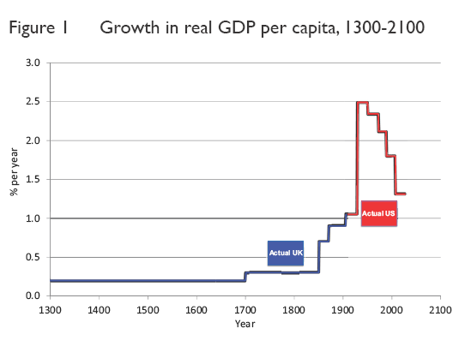

Slide 32
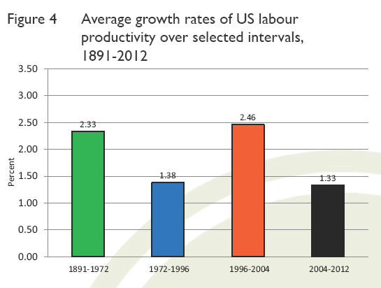

Slide 33
  Globalization
What if Gordon’s conjecture is true?
Global trade in services has helped the skilled, educated, middle class in India (unlike in the USA)
Cross country teams (Manager – Worker combinations)

Slide 34
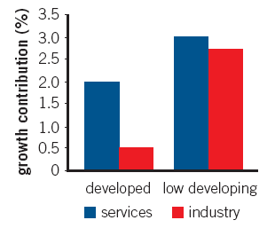
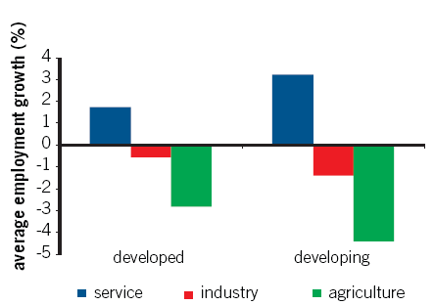
Service Sector: Rev or Sputter
Sources of Growth 1980-2009
Job Creation (1991-2006)
The potential for explosive growth was usually only seen in the manufacturing sector: this is no longer the case. (Ejaz Ghani et. al. (2012) Service with a Smile)

Slide 35
Percentage share of labor intensive manufacturing in world market shares (2008)
 | India | China
Resource based products | 2.6 | 12.7
Textiles | 4.7 | 24.0
Misc. Manufacturing | 1.5 | 30.0
Clothing & footwear | 3.3 | 40.6
Total | 2.1 | 20.4

Slide 36
Sector Share in Employment: All India (%)
Sectors | 1993-94 | 1999-00 | 2004-05 | 2009-10
Agriculture | 64.0 | 60.3 | 56.3 | 51.3
Manufacturing | 10.6 | 11.0 | 12.3 | 11.5
Construction | 3.2 | 4.4 | 5.7 | 9.6
Secondary | 15.0 | 16.2 | 18.8 | 22.0
Trade, Hotel | 7.6 | 10.3 | 10.9 | 11.4
Transp. & Com | 2.9 | 3.6 | 4.1 | 4.5
Finance insurance etc | 1.0 | 1.2 | 1.7 | 2.3
Community, social etc | 9.6 | 8.3 | 8.2 | 8.6
Tertiary Sector | 21.1 | 23.4 | 24.9 | 26.7
Total | 100.0 | 100.0 | 100.0 | 100.0

Slide 37
Urban workforce in India (2009-10)
Workforce Distribution in Urban India (2009-10)
Particulars | No. | %
Self employed in household enterprise | 48,912,887 | 33.7
Unpaid family worker (in household enterprise) | 14,628,204 | 10.1
Regular salaried/ wage employee | 47,366,202 | 32.7
Casual wage labour | 419,209 | 0.3
In other types of work | 29,403,484 | 20.3
Unemployed | 4,270,708 | 2.9
Total | 145,000,694 | 100

Slide 38
Urban workforce in India (2009-10)
Distribution of Urban Workforce by Industry
Industry | No. | Percent
Agriculture and Mining | 13,966,403 | 9.92
Manufacturing | 27,598,446 | 19.61
Construction | 17,792,005 | 12.64
Trade, Hotels and Restaurants | 39,618,606 | 28.15
Transport, Storage and Communication | 10,891,631 | 7.74
Other services | 30,854,158 | 21.93
Total | 140,721,249 | 100

Slide 39
Sectors | 1983 to 93-94 | 1993-94-2004-05 | 1999-00 to 2009-10 | 2004-05 to 2009-10
Agriculture | 0.49 | 0.26 | -0.05 | -0.53
Manf | 0.41 | 0.47 | 0.25 | -0.11
Construction | 1.16 | 0.94 | 1.06 | 1.22
Secondary | 0.53 | 0.59 | 0.60 | 0.39
Trade, Hotel | 0.67 | 0.61 | 0.30 | 0.12
Trans & Com | 0.56 | 0.49 | 0.25 | 0.13
Fin & insu | 0.39 | 0.99 | 0.81 | 0.47
Com, social | 0.67 | 0.06 | 0.28 | 0.12
Tertiary Sec | 0.57 | 0.43 | 0.30 | 0.14
Total | 0.41 | 0.29 | 0.20 | 0.02
Elasticity declined for all sectors particularly manufac. Except constr.

Slide 40
Service: Rev or Sputter
Sources of Growth 1980-2009
Job Creation (1991-2006)
The potential for explosive growth was usually only seen in the manufacturing sector: this is no longer the case. (Ejaz Ghani et. al. (2012) Service with a Smile)

Slide 41
Tailwinds > Headwinds
Agglomeration Effects, Knowledge Spill Over, Division of labour
Mass production, Increased productivity
Natural advantage, Transport costs, Job location affects the housing decisions, Workers will live in vicinity of factory emergence of towns/cities which in turn will attract other industries to support the population.
Slow infrastructure development
Lack of labour intensive manufacturing sector*
Unable to take advantage of demographic dividend: Low education and skill development
Slow social sector development: poverty, inequality and human development
Governance problems
Conditions for Socio-Economic Leapfrog

Slide 42
Tackling the Headwinds
Learn from East Asia
Increase education (RTE, Skill)
Increase workforce participation rate (Education, Marriage)
Fix infrastructure (Governance)
Increase investment GDP ratio (Savings Rate, Physical savings)

